Slide 1
Hypothesis testing
I N T R O D U C T I O N TO STAT I ST I C S
George Boorman
Curriculum Manager, DataCamp

Slide 2

Why do we need to know about hypothesis testing?
Hypothesis testing is used to compare populations
Hypothesis testing is everywhere!
Can a change in price lead to increased revenue?
Will changing a website address result in increased traffic?
Is a medication effective in the treatment of a health condition?
¹ Image credit: https://unsplash.com/@towfiqu999999

Slide 3

The history of hypothesis testing
Hypothesis testing dates back to the 1700s!
Human sex ratio
More male births than female births
¹ Image credit: https://unsplash.com/@kellysikkema

Slide 4
Assume nothing!
Start by assuming no difference exists This is called the null hypothesis
Male versus female birth ratio
Null hypothesis:
No difference in gender birth ratio between women who do and do not take vitamin C consumption
Alternative hypothesis:
A difference exists in gender birth ratio between the two populations
More female births occur among women taking vitamin C supplements

Slide 5


Hypothesis testing workflow
Define the target populations
Adult women taking or not taking vitamin C supplements
Develop null and alternative hypotheses Births are equally like to be male or female in both populations
More births are female among women taking vitamin C supplements
Collect or access sample data
Perform statistical tests on the sample data Draw conclusions about the population

Slide 6

How much data do we need?
Central limit theorem
Mean male and female births gets closer to the population means as sample size increases
Time and resource intensive
Look at peer-reviewed research on similar hypothesis tests to decide on the sample size
¹ Image credit: https://unsplash.com/@jxnsartstudio

Slide 7
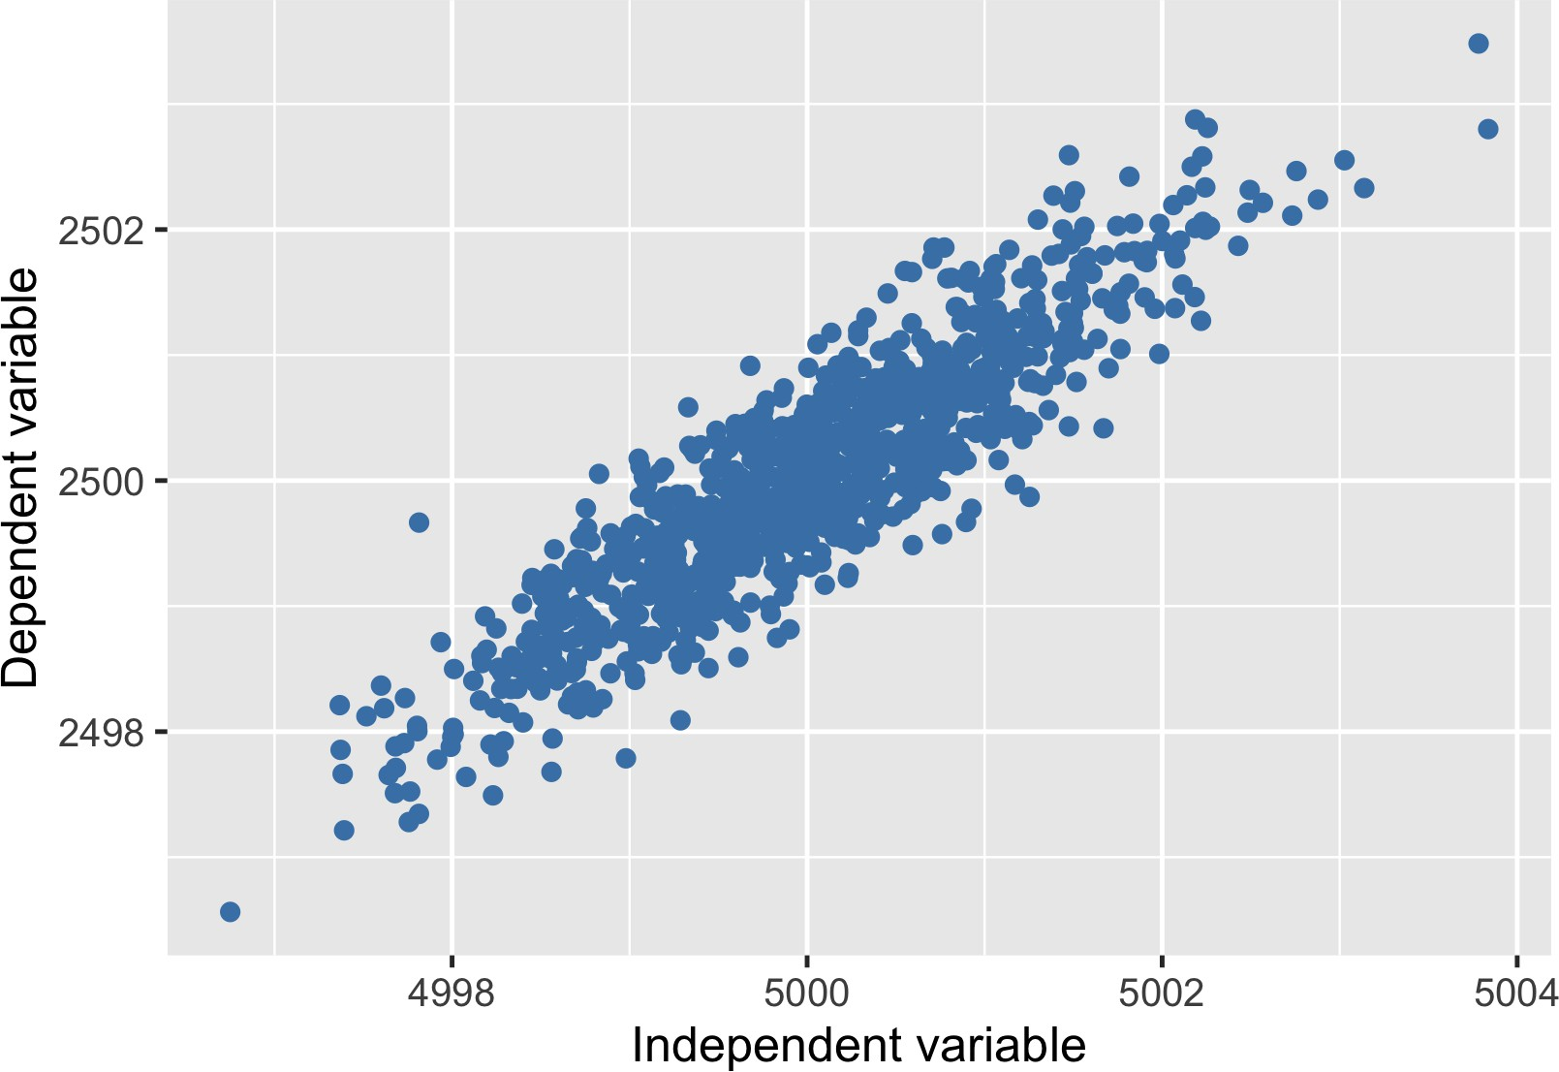
Independent and dependent variables
Independent variable: Unaffected by other data
Vitamin C supplementation
Dependent variable: Affected by other data
Birth gender ratio
Commonly used to describe hypothesis test results

Slide 8
Experiments
I N T R O D U C T I O N TO STAT I ST I C S
George Boorman
Curriculum Manager, DataCamp

Slide 9

Experiments, treatment, and control
Experiments are a subset of hypothesis testing
Experiments are not just conducted in academia
Experiments aim to answer: What is the effect of the treatment on the response?
Treatment: independent variable Response: dependent variable
¹ Image credit: https://unsplash.com/@nci

Slide 10
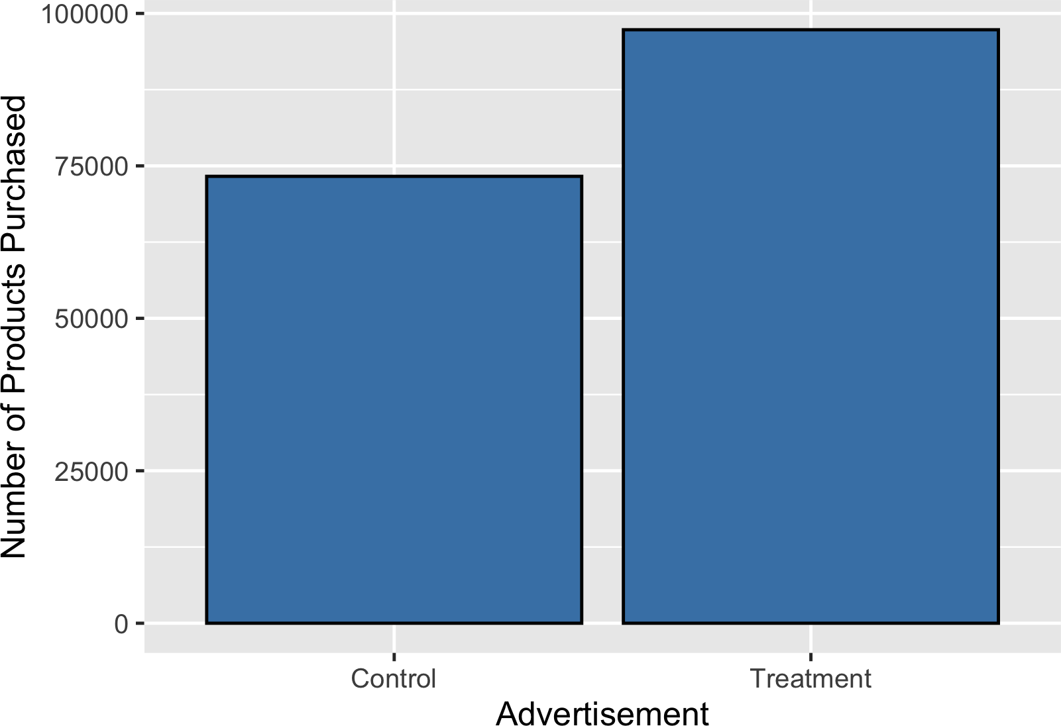
Advertising as a treatment
What is the effect of an advertisement on the number of products purchased?
Treatment: advertisement
Response: number of products purchased

Slide 11
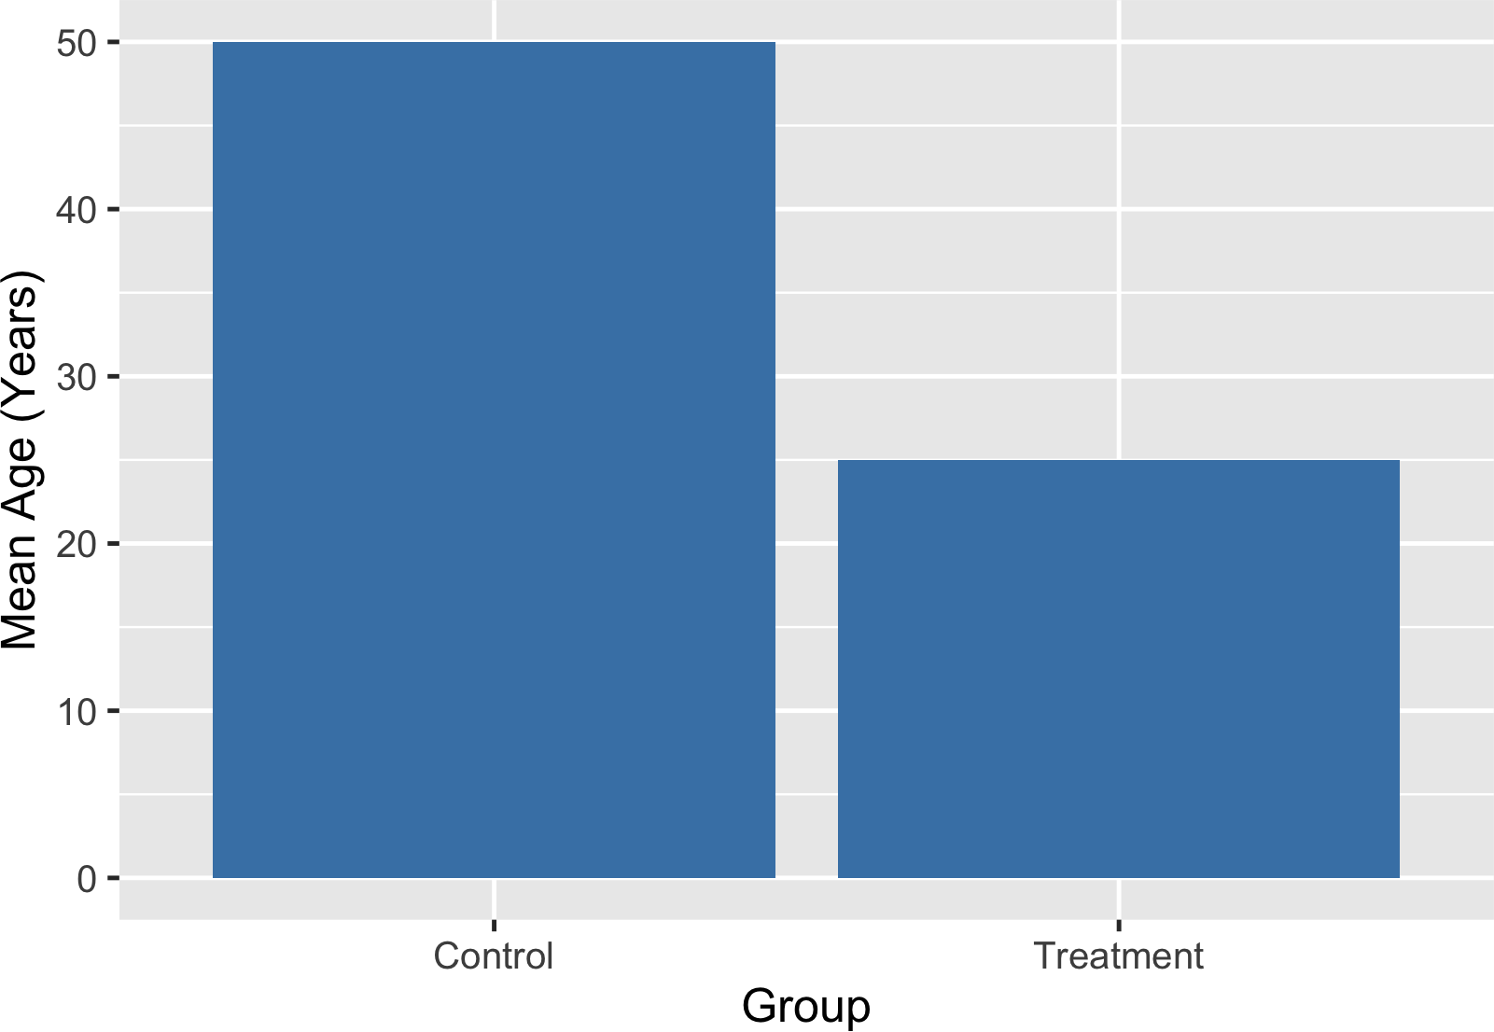
Controlled experiments
Participants are assigned to either the treatment group or the control group
Treatment group sees the advertisement
Control group does not see the advertisement
Groups should be comparable to avoid introducing bias
If groups are not comparable, this could lead to drawing incorrect conclusions

Slide 12
The gold standard of experiments
Randomization
Participants are assigned to treatment/control randomly, not based on any other characteristics
Choosing randomly helps ensure that groups are comparable Known as a randomized controlled trial
Blinding
Participants will not know which group they're in
Participants receive a placebo, which resembles the treatment but has no effect In clinical trials it is common to use a sugar pill

Slide 13
The gold standard of experiments
Double-blind randomized controlled trial
Person administering the treatment/running the study doesn't know whether the treatment is real or a placebo
Prevents bias in the response and/or analysis of results
Fewer opportunities for bias = more reliable conclusion about causation

Slide 14


Randomized Controlled Trials vs. A/B testing
Randomized controlled trial
Can be multiple treatment groups
Popular in science, clinical research
A/B testing
Popular in marketing, engineering
Only split evenly into two groups
¹ Image credits: https://unsplash.com/@towfiqu999999; https://unsplash.com/@thisisengineering

Slide 15
Correlation
I N T R O D U C T I O N TO STAT I ST I C S
George Boorman
Curriculum Manager, DataCamp

Slide 16
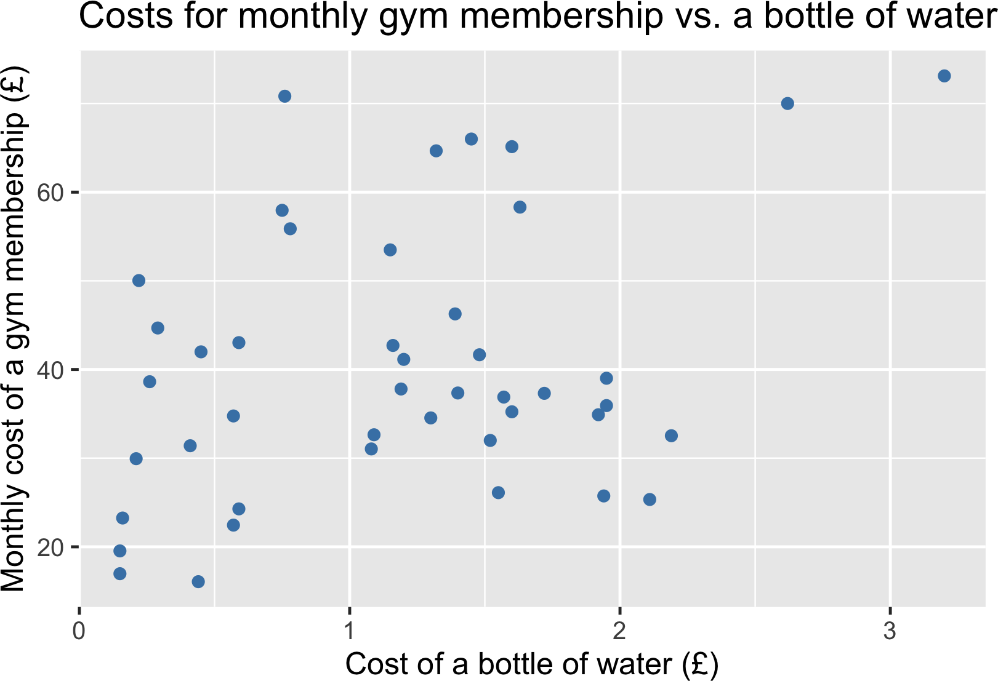
Relationships between two variables

Slide 17
Pearson correlation coefficient
Published by Karl Pearson in 1896!
Quantifies the strength of a relationship between two variables Number between minus one and one
Magnitude corresponds to strength of relationship
Sign (+ or -) corresponds to direction of relationship
¹ https://royalsocietypublishing.org/doi/10.1098/rsta.1896.0007

Slide 18
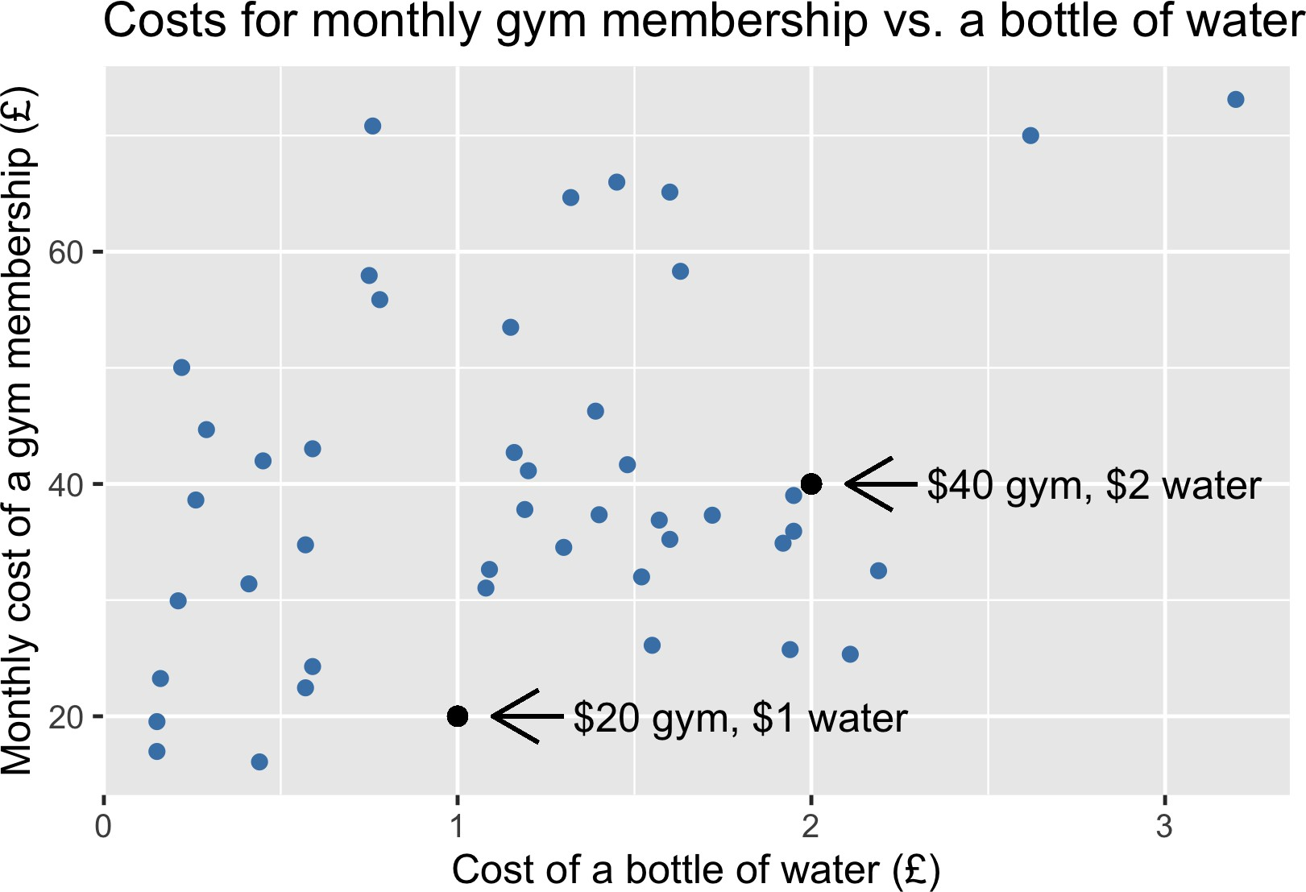
Linear relationships
Linear = proportionate changes between dependent and independent variables

Slide 19
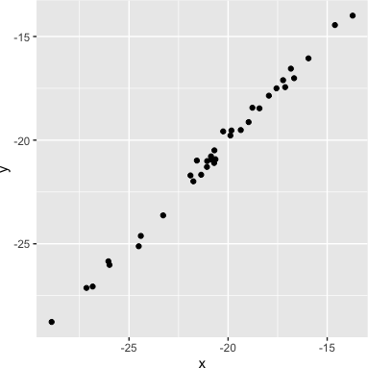
Values = strength of the relationship
0.99 (very strong relationship)

Slide 20
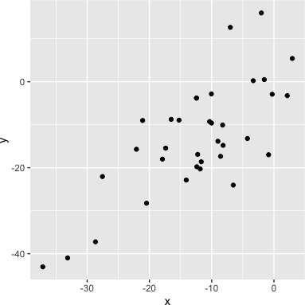
Values = strength of the relationship
0.99 (very strong relationship) 0.75 (strong relationship)

Slide 21
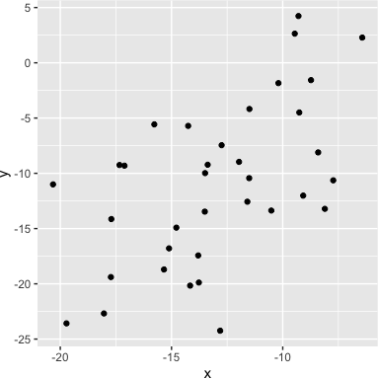
Values = strength of the relationship
0.56 (moderate relationship)

Slide 22
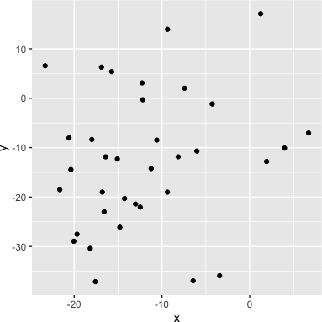
Values = strength of the relationship
0.56 (moderate relationship) 0.21 (weak relationship)

Slide 23
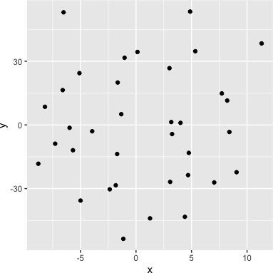
Values = strength of the relationship
0.04 (no relationship)
Knowing the value of x doesn't tell us anything about y

Slide 24
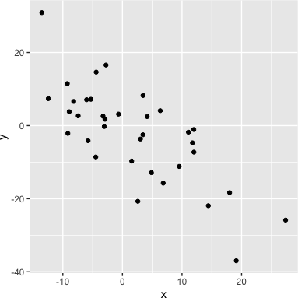
Sign = direction
0.75: as x increases, y increases
-0.75: as x increases, y decreases

Slide 25
Gym costs vs. water costs

Slide 26
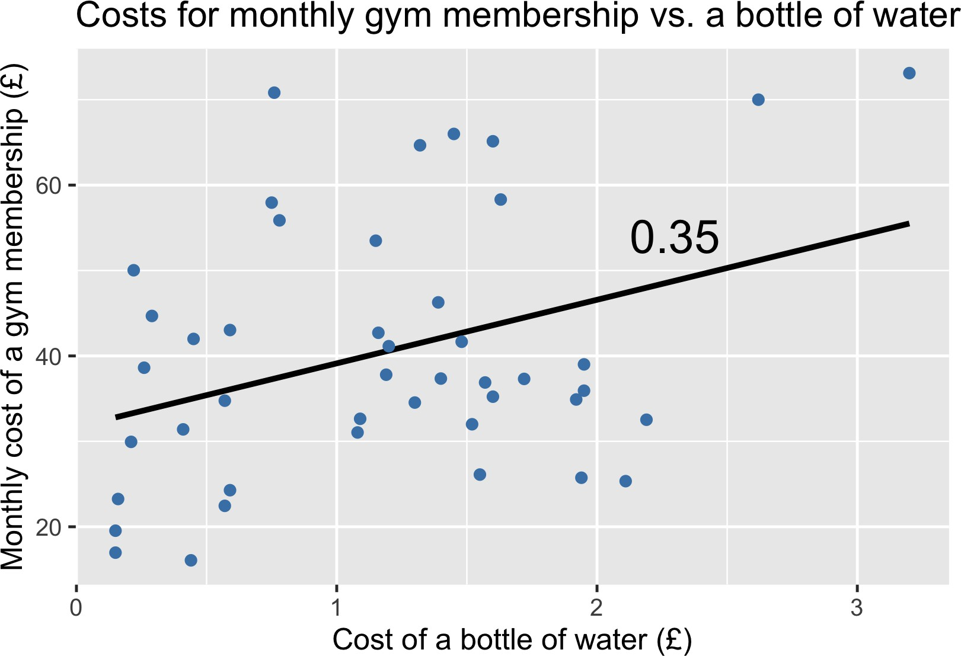
Adding a trendline

Slide 27
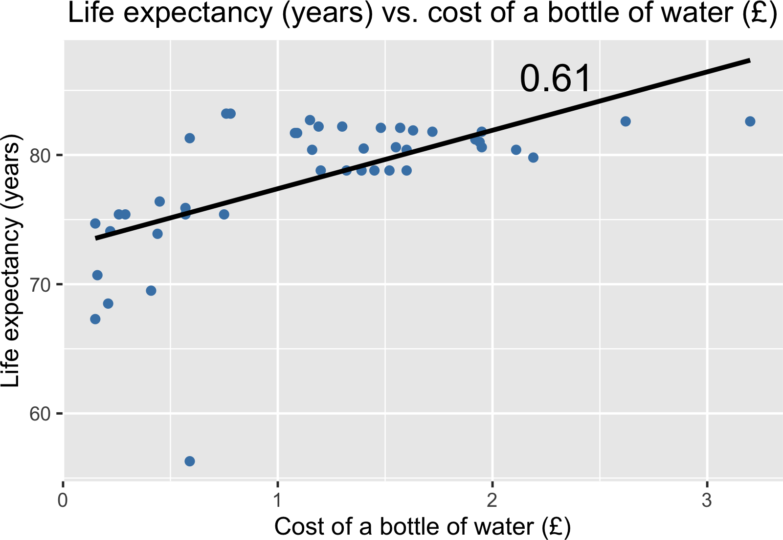
Life expectancy vs. cost of a bottle of water

Slide 28


Correlation does not equal causation
Will increasing the cost of water result in an increase in life expectancy?
Correlation does not equal causation
¹ Image credit: https://unsplash.com/@micheile; https://unsplash.com/@jon_chng

Slide 29

Confounding variables
What else might be affecting life expectancy?
A bottle of water costs more in countries with strong economies
These countries generally offer access to high-quality healthcare
The strength of the economy could be a
confounding variable
A confounding variable is not measured, but may affect the relationship between our variables

Slide 30
Interpreting hypothesis test results
I N T R O D U C T I O N TO STAT I ST I C S
George Boorman
Curriculum Manager, DataCamp

Slide 31


Life expectancy in Chicago vs. Bangkok
Null hypothesis:
There is no difference in life expectancy between Chicago residents and Bangkok residents
Alternative hypothesis:
Chicago residents have a longer life expectancy than Bangkok residents
Chicago
Bangkok

Slide 32
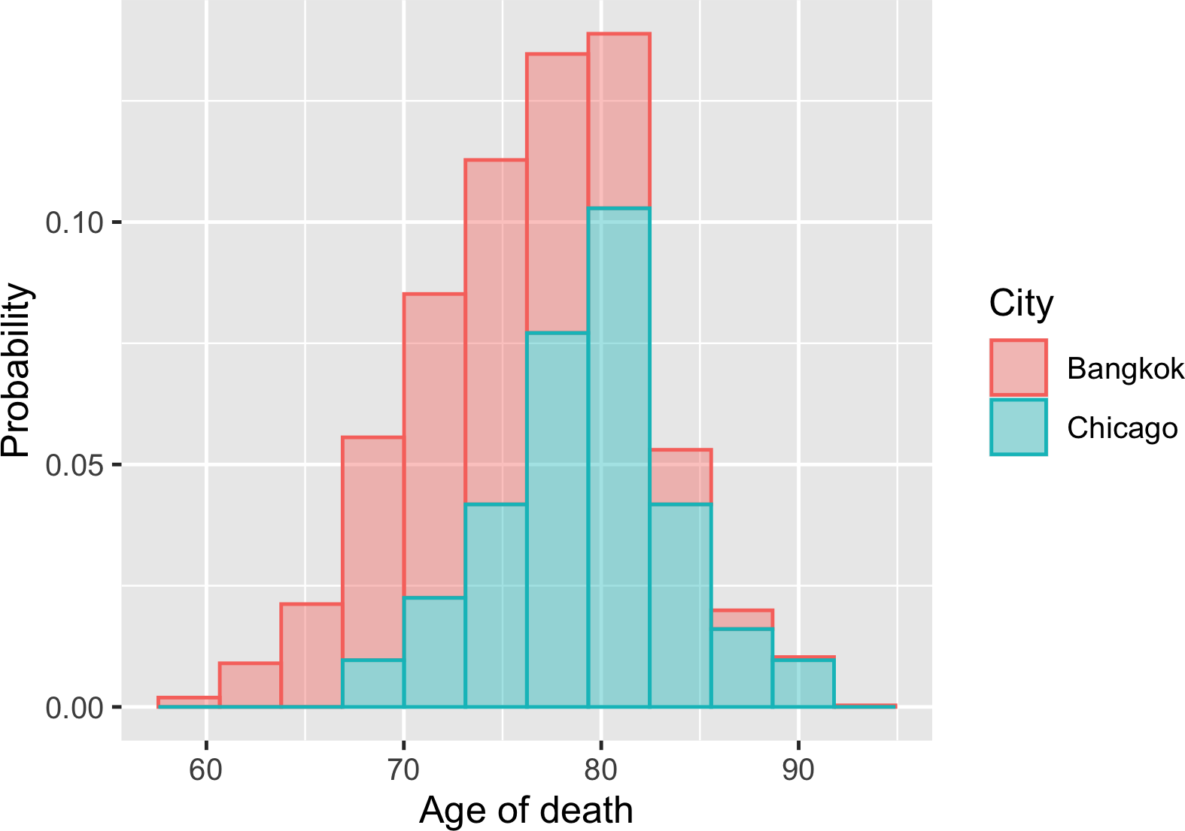
Sampling distribution

Slide 33
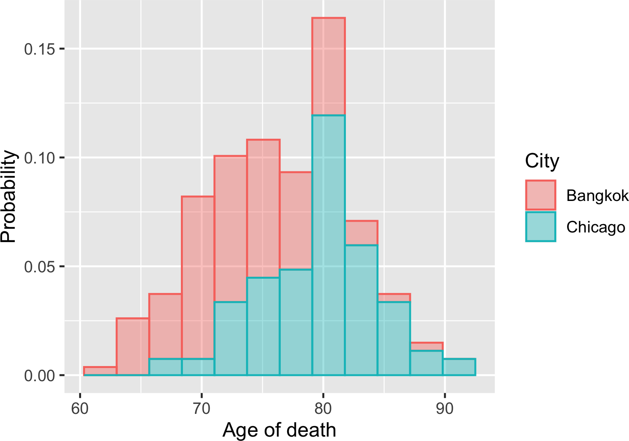
Different samples

Slide 34
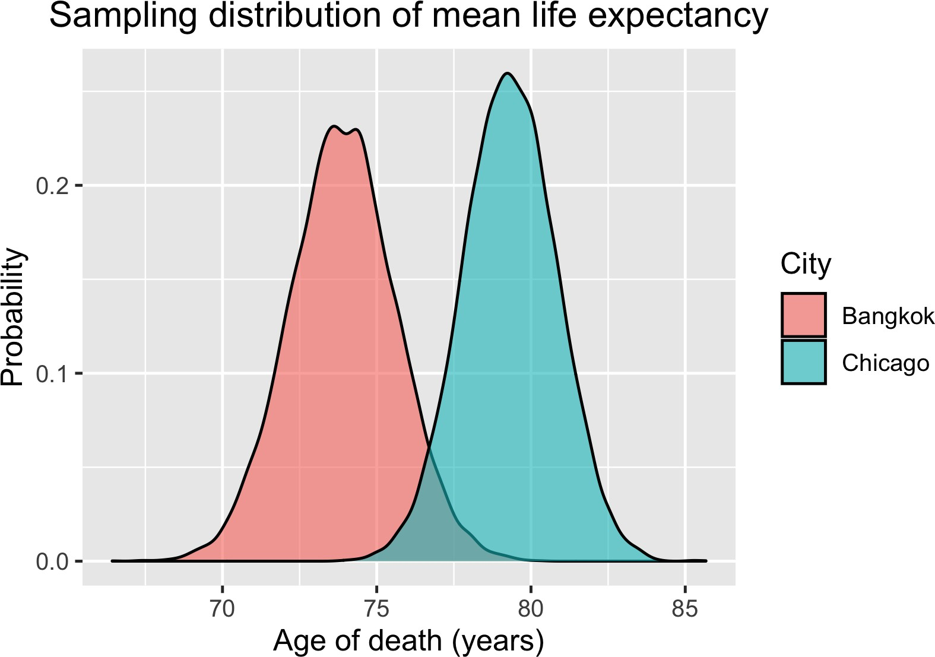
Sampling distribution of mean life expectancy

Slide 35
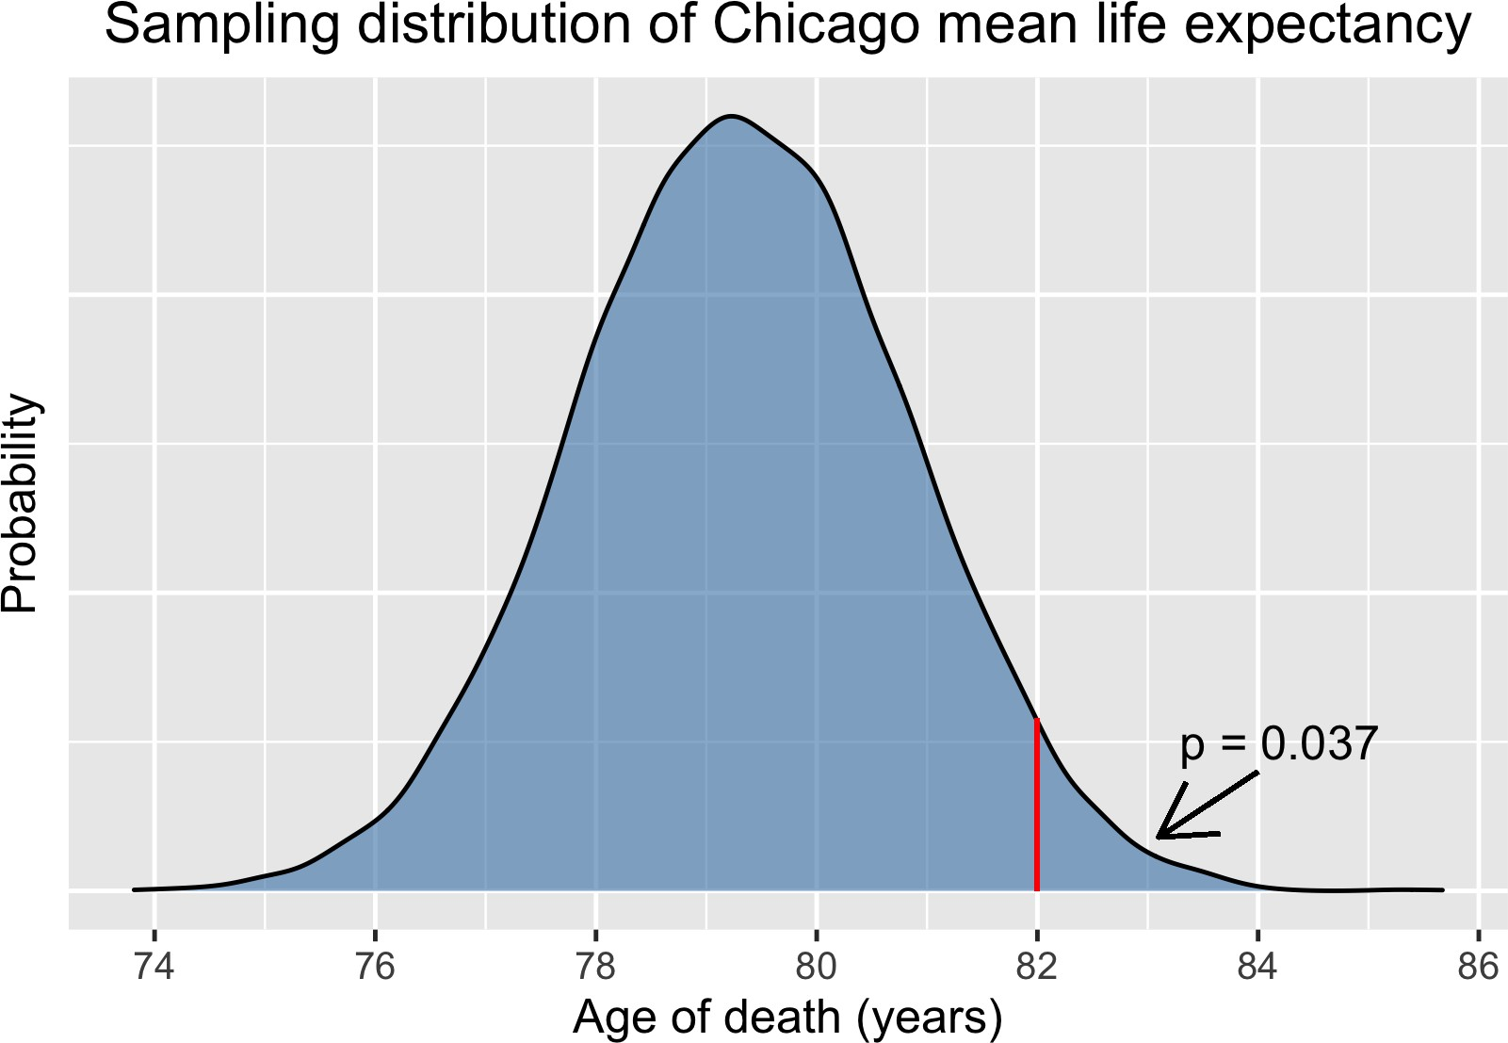
p-value
p
Probability of achieving this result, assuming the null hypothesis is true

Slide 36
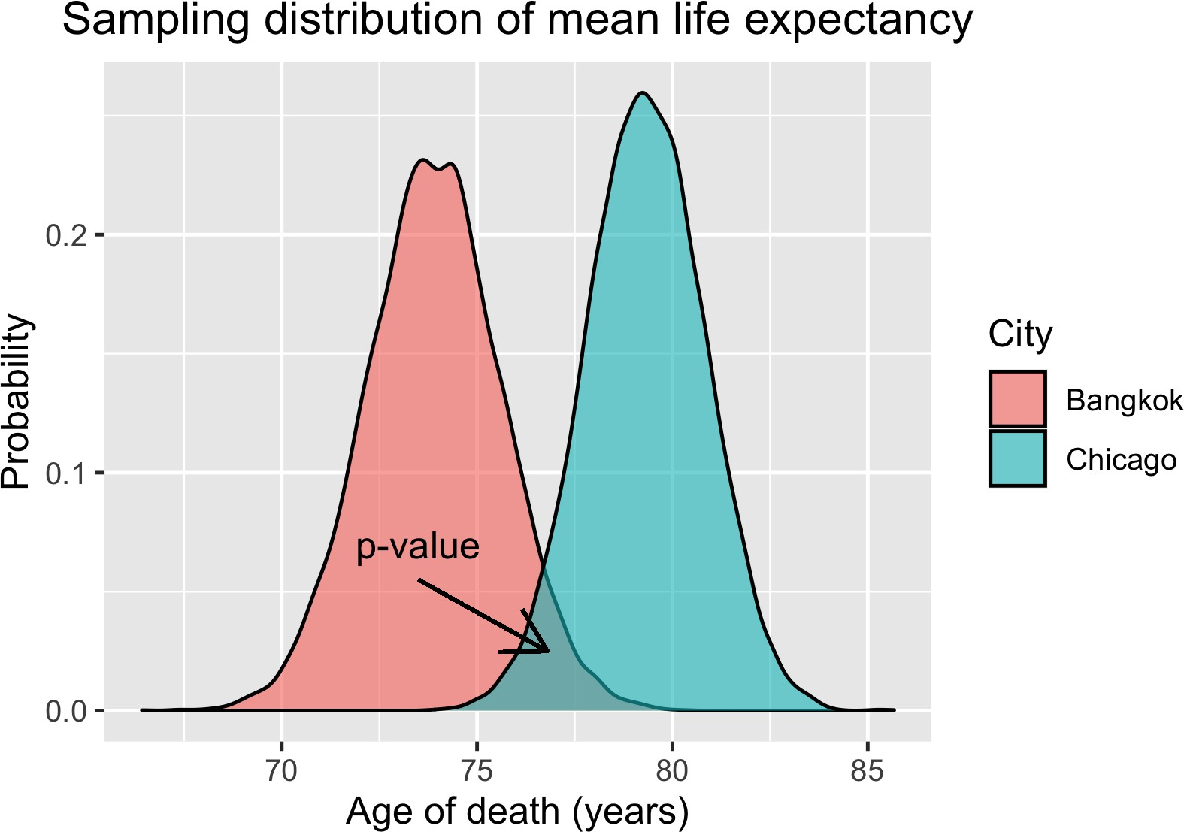
p-value

Slide 37
Significance level (α)
To reduce the risk of drawing a false conclusion:
Set a probability threshold for rejecting the null hypothesis
Known as α or significance level
Decided before data collection to minimize bias:
Otherwise they could choose a different α to serve their interests
A typical threshold is 0.05
5% chance of wrongly concluding that Chicago residents live longer than Bangkok residents
If p ≤ α, reject the null hypothesis
These results are said to be statistically significant

Slide 38
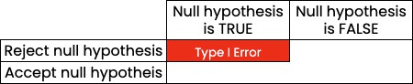
Type I/II error

Slide 39
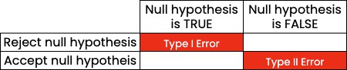
Type I/II error

Slide 40
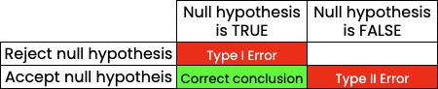
Type I/II error

Slide 41
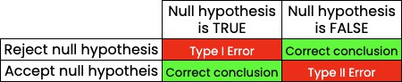
Type I/II error

Slide 42
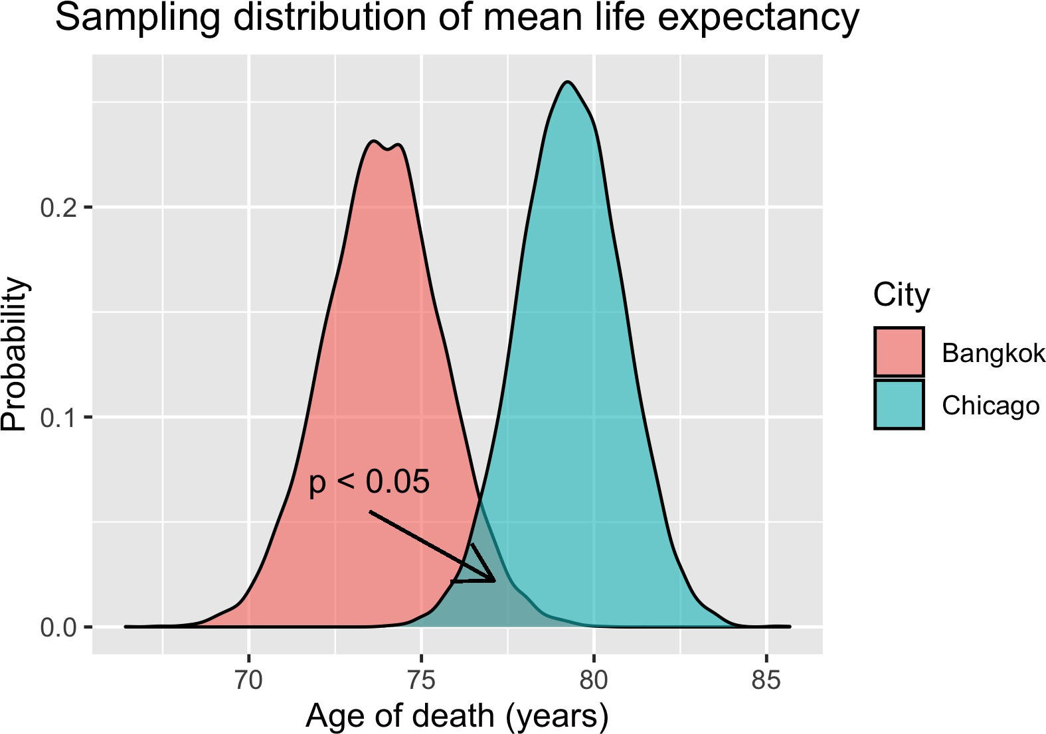
Drawing a conclusion

